Slide 1
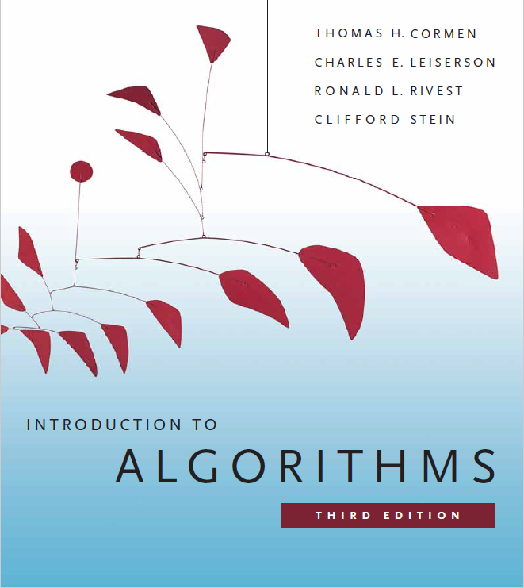

Exploring Graphs
Prepared by Shmuel Wimer
Instructed by Deganit Armon and Shmuel Wimer

Slide 2
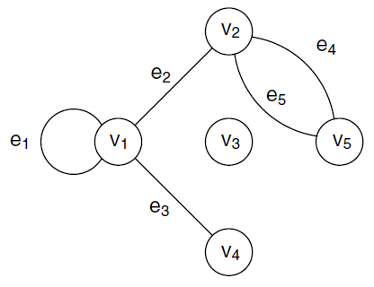
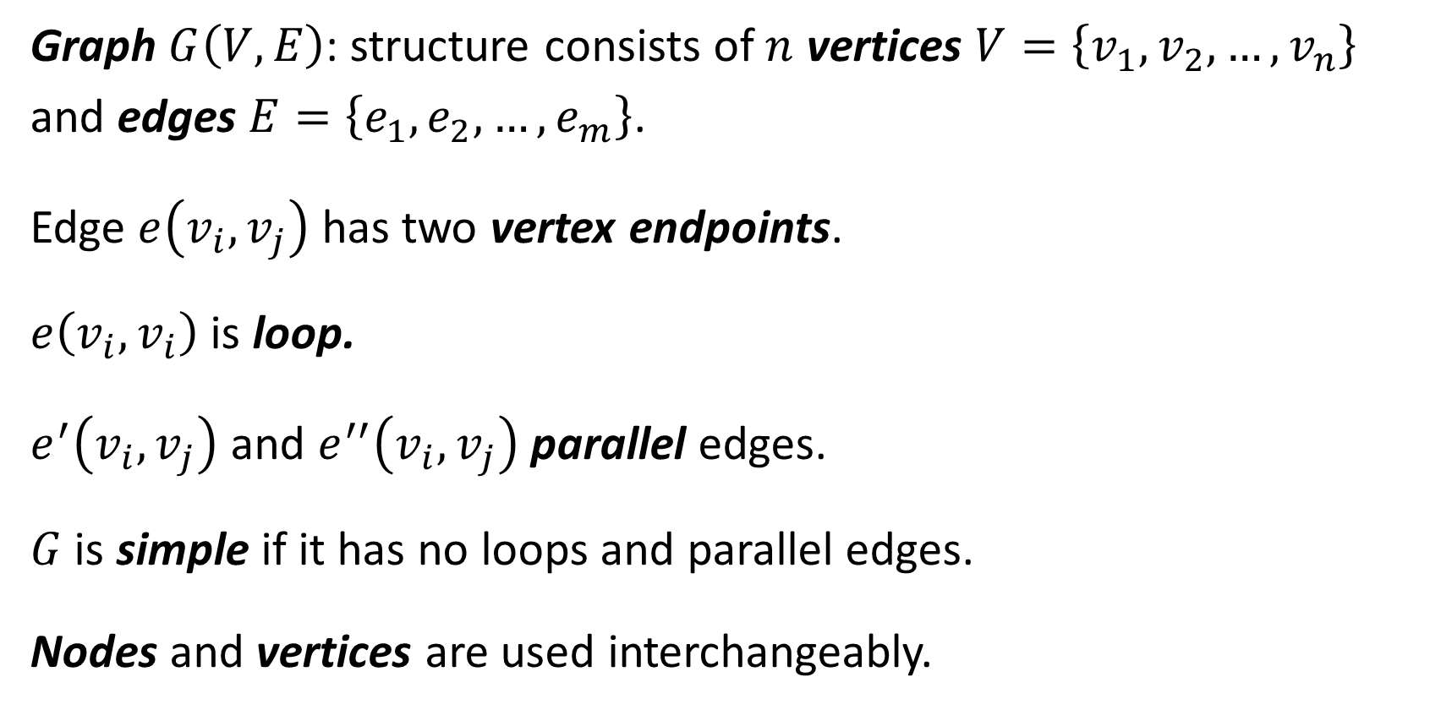
Definitions
Graph $G\left(V,E\right)$: structure consists of $n$ vertices $V=\left\{v_{1},v_{2},…,v_{n}\right\}$ and edges $E=\left\{e_{1},e_{2},…,e_{m}\right\}$.
Edge $e\left(v_{i},v_{j}\right)$ has two vertex endpoints.
$e\left(v_{i},v_{i}\right)$ is loop.
$e^{′}\left(v_{i},v_{j}\right)$ and $e^{′′}\left(v_{i},v_{j}\right)$ parallel edges.
$G$ is simple if it has no loops and parallel edges.
Nodes and vertices are used interchangeably.

Slide 3
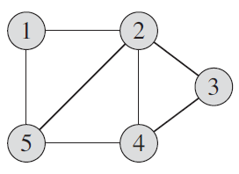
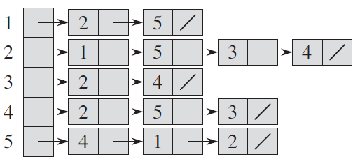
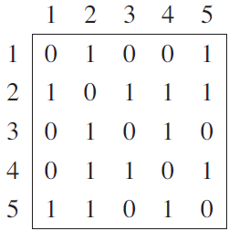
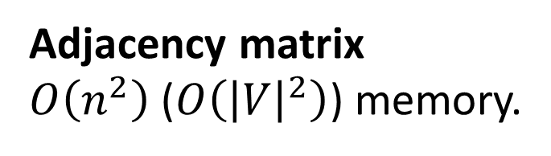
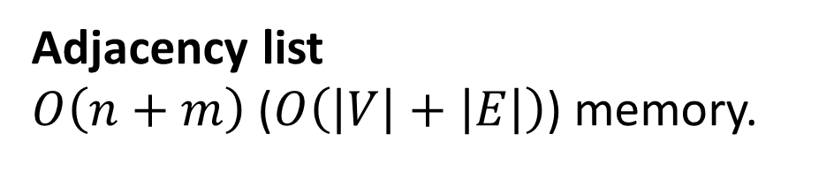
Adjacency list
$O\left(n+m\right)$ ($O\left(\left|V\right|+\left|E\right|\right)$) memory.
Adjacency matrix
$O\left(n^{2}\right)$ ($O\left({\left|V\right|}^{2}\right)$) memory.

Slide 4

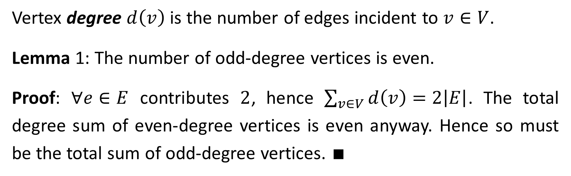




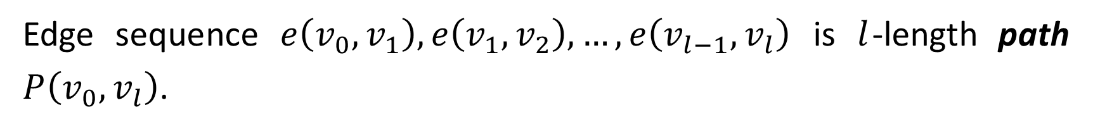
Vertex degree $d\left(v\right)$ is the number of edges incident to $v∈V$.
Lemma 1: The number of odd-degree vertices is even.
Proof: $∀e∈E$ contributes $2$, hence $\sum_{v∈V}{d\left(v\right)}=2\left|E\right|$. The total degree sum of even-degree vertices is even anyway. Hence so must be the total sum of odd-degree vertices. $∎$
Edge sequence $e\left(v_{0},v_{1}\right),e\left(v_{1},v_{2}\right),…,e\left(v_{l−1},v_{l}\right)$ is $l$-length path $P\left(v_{0},v_{l}\right)$.
$$v_{1}$$
$$v_{l−1}$$
$$v_{l}$$
$$v_{0}$$
$$v_{2}$$

Slide 5
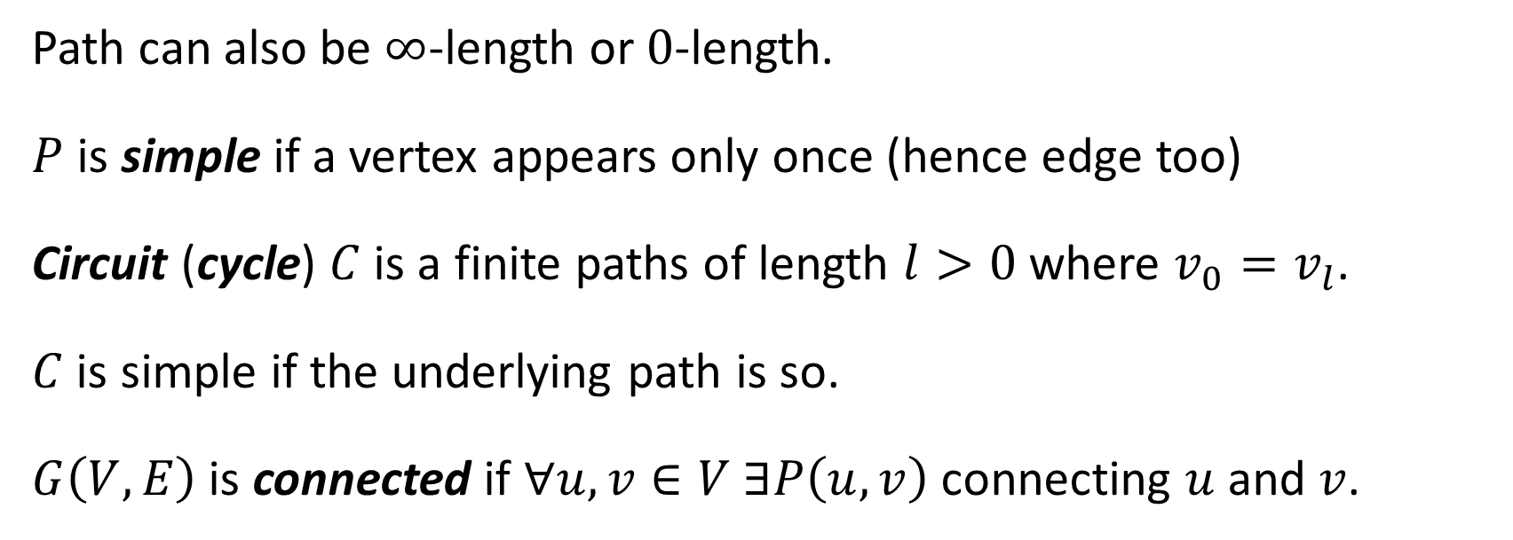
Path can also be $∞$-length or $0$-length.
$P$ is simple if a vertex appears only once (hence edge too)
Circuit (cycle) $C$ is a finite paths of length $l>0$ where $v_{0}=v_{l}$.
$C$ is simple if the underlying path is so.
$G\left(V,E\right)$ is connected if $∀u,v∈V$ $∃P\left(u,v\right)$ connecting $u$ and $v$.

Slide 6
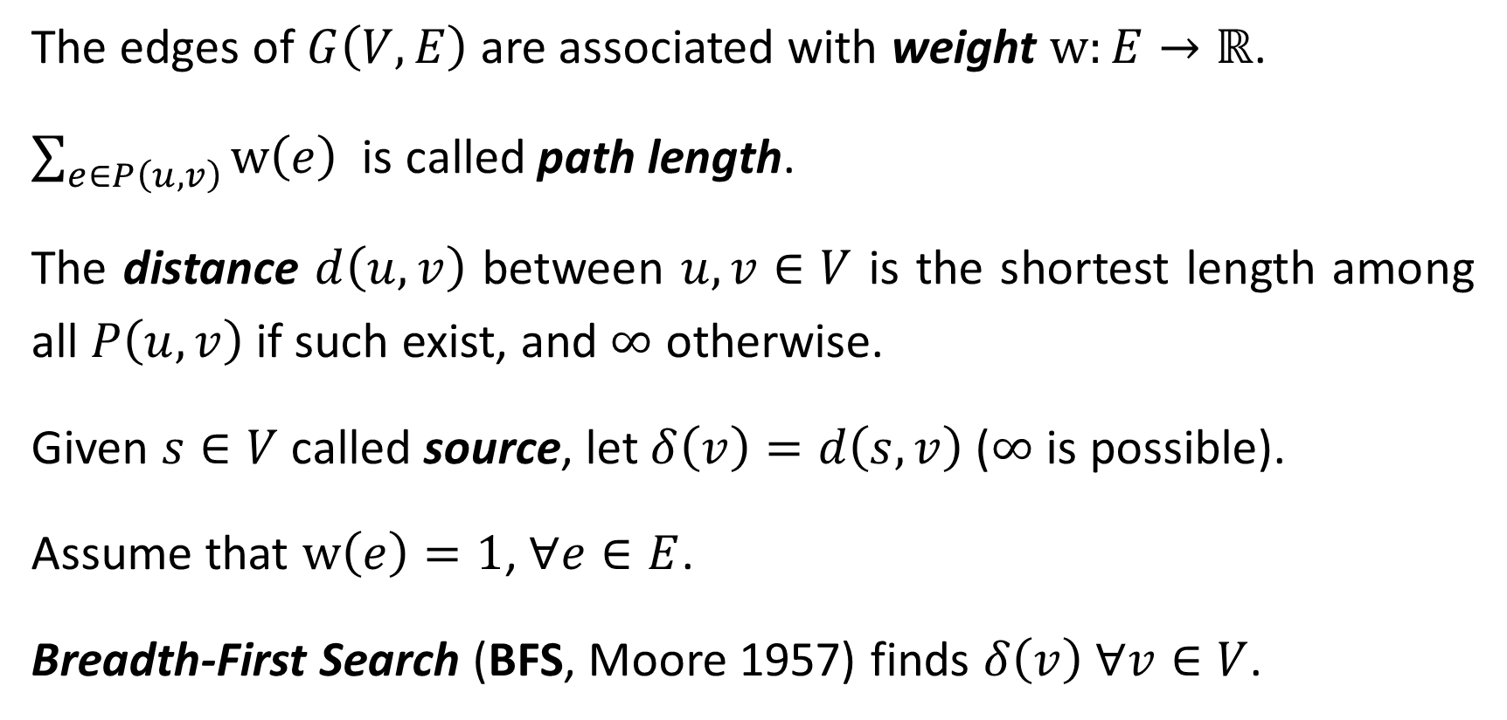
Shortest-Path Algorithms
The edges of $G\left(V,E\right)$ are associated with weight $\text{w}:E→ℝ$.
$\sum_{e∈P\left(u,v\right)}{\text{w}\left(e\right)}$ is called path length.
The distance $d\left(u,v\right)$ between $u,v∈V$ is the shortest length among all $P\left(u,v\right)$ if such exist, and $∞$ otherwise.
Given $s∈V$ called source, let $δ\left(v\right)=d\left(s,v\right)$ ($∞$ is possible).
Assume that $\text{w}\left(e\right)=1$, $∀e∈E$.
Breadth-First Search (BFS, Moore 1957) finds $δ\left(v\right)$ $∀v∈V$.

Slide 7


$$s$$
$$s$$

Slide 8
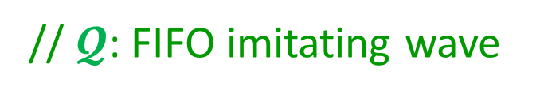



$\text{Procedure} \text{BFS}\left(G, s;λ\right)$
$∀v∈V λ\left(v\right)=∞; λ\left(s\right)=0$
$𝓠=∅$ ; $s→𝓠$
$𝓣=\left\{s\right\}$
$\text{while} 𝓠≠∅$
$u=\text{DEQUEUE}\left(𝓠\right)$
$∀ e\left(u,v \right)$
$\text{if} (v∉𝓣\text{)}$
$𝓣=𝓣∪\left\{v\right\}$
$λ\left(v\right)=λ\left(u\right)+1$
$\text{EN}\text{QUEUE}\left(v,𝓠\right)$
// output $λ$: labels
// initialization
// $𝓠$: FIFO imitating wave
// $𝓣$: already labeled (done) vertices
// Expand “outwards” from wave
// get vertex from wave
// Label unlabeled
// Labeled will never changed
// put new labeled in wave

Slide 9
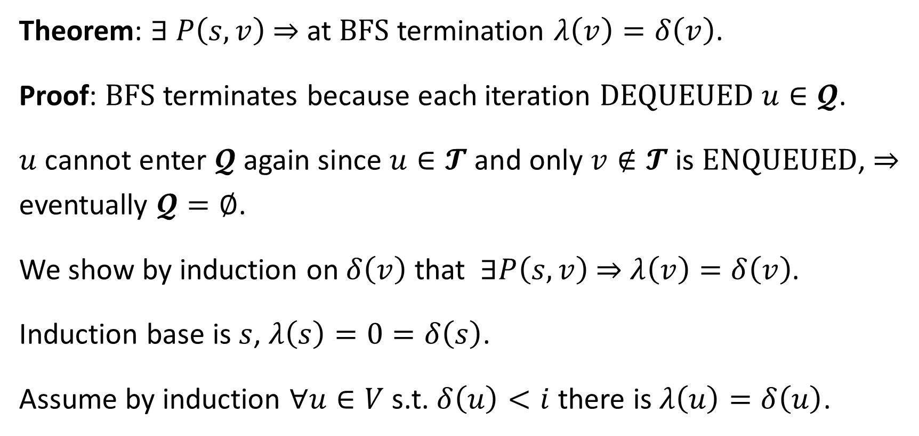
Theorem: $∃ P\left(s,v\right)$ ⇒ at $\text{BFS}$ termination $λ\left(v\right)=δ\left(v\right)$.
Proof: $\text{BFS}$ terminates because each iteration DEQUEUED $u∈𝓠$.
$u$ cannot enter $𝓠$ again since $u∈𝓣$ and only $v∉𝓣$ is ENQUEUED, ⇒ eventually $𝓠=∅$.
We show by induction on $δ\left(v\right)$ that $∃P\left(s,v\right)$ ⇒ $λ\left(v\right)=δ\left(v\right)$.
Induction base is $s$, $λ\left(s\right)=0=δ\left(s\right)$.
Assume by induction $∀u∈V$ s.t. $δ\left(u\right)<i$ there is $λ\left(u\right)=δ\left(u\right)$.

Slide 10


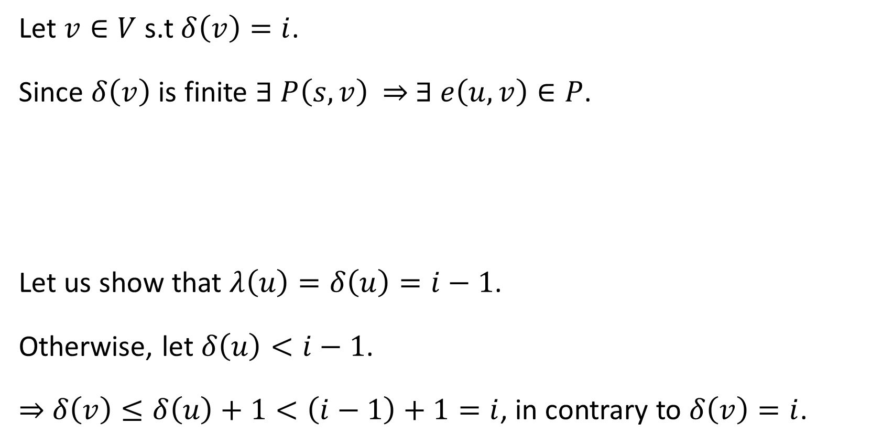


Let $v∈V$ s.t $δ\left(v\right)=i$.
Since $δ\left(v\right)$ is finite $∃ P\left(s,v\right)$ ⇒ $∃ e\left(u,v\right)∈P$.
Let us show that $λ\left(u\right)=δ\left(u\right)=i−1$.
Otherwise, let $δ\left(u\right)<i−1$.
⇒ $δ\left(v\right)≤δ\left(u\right)+1<\left(i−1\right)+1=i$, in contrary to $δ\left(v\right)=i$.
$$s$$
$$P\left(s,v\right)$$
$$v$$
$$u$$

Slide 11





Now by induction hypothesis $λ\left(u\right)=δ\left(u\right)=i−1$.
Once $u∈𝓠$ is $\text{DEQUEUED}$ $e\left(u,v\right)$ is detected.
Let $v∉𝓣$ (unlabeled).
$v$ labeled from $u$ ⇒ $λ\left(v\right)=$ $λ\left(u\right)+1=i=δ\left(v\right)$, and labeling occurs only once, so we are done.
$$s$$
$$P\left(s,v\right)$$
$$v$$
$$u$$

Slide 12

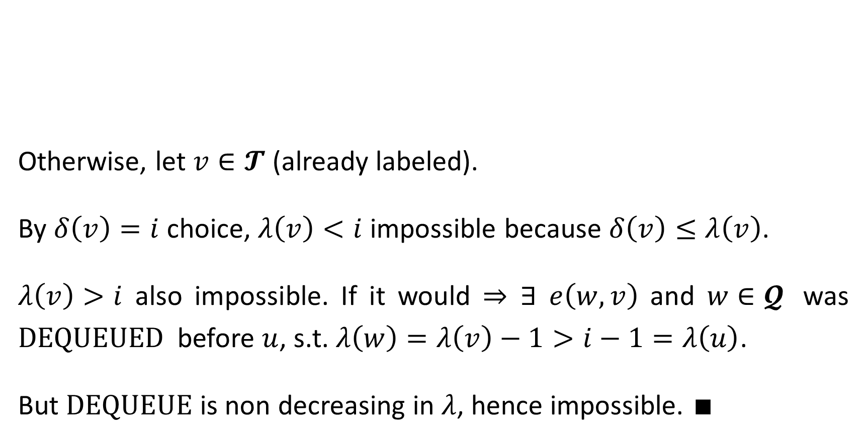
$$w$$
Otherwise, let $v∈𝓣$ (already labeled).
By $δ\left(v\right)=i$ choice, $λ\left(v\right)<i$ impossible because $δ\left(v\right)≤λ\left(v\right)$.
$λ\left(v\right)>i$ also impossible. If it would ⇒ $∃$ $e\left(w,v\right)$ and $w∈𝓠$ was $\text{DEQUEUED}$ before $u$, s.t. $λ\left(w\right)=λ\left(v\right)−1>i−1=λ\left(u\right)$.
But $\text{DEQUEUE}$ is non decreasing in $λ$, hence impossible. $∎$
$$s$$
$$P\left(s,v\right)$$
$$v$$
$$u$$

Slide 13
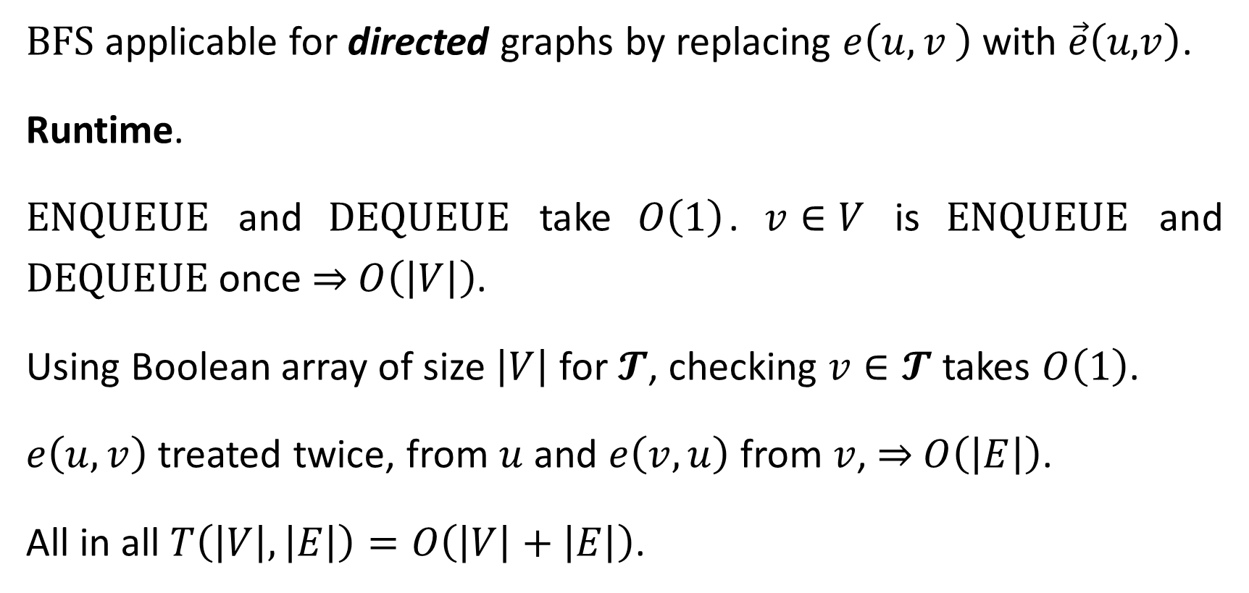
BFS applicable for directed graphs by replacing $e\left(u,v \right)$ with $\vec{e}\left(u\text{,}v\right)$.
Runtime.
$\text{ENQUEUE}$ and $\text{DEQUEUE}$ take $O\left(1\right)$. $v∈V$ is $\text{ENQUEUE}$ and $\text{DEQUEUE}$ once ⇒ $O\left(\left|V\right|\right)$.
Using Boolean array of size $\left|V\right|$ for $𝓣$, checking $v∈𝓣$ takes $O\left(1\right)$.
$e\left(u,v\right)$ treated twice, from $u$ and $e\left(v,u\right)$ from $v$, ⇒ $O\left(\left|E\right|\right)$.
All in all $T\left(\left|V\right|,\left|E\right|\right)=O\left(\left|V\right|+\left|E\right|\right)$.

Slide 14
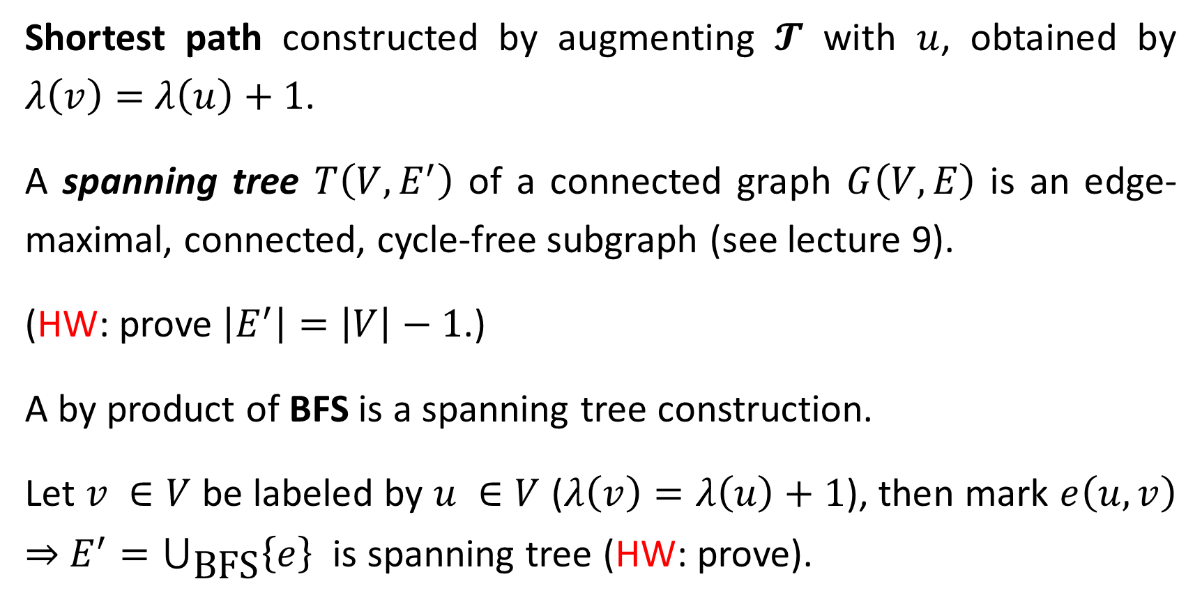
Shortest path constructed by augmenting $𝓣$ with $u$, obtained by $λ\left(v\right)=$ $λ\left(u\right)+1$.
A spanning tree $T\left(V, E^{′}\right)$ of a connected graph $G\left(V,E\right)$ is an edge-maximal, connected, cycle-free subgraph (see lecture 9).
(HW: prove $\left|E^{′}\right|=\left|V\right|−1$.)
A by product of BFS is a spanning tree construction.
Let $v ∈V$ be labeled by $u ∈V$ ($λ\left(v\right)=λ\left(u\right)+1$), then mark $e\left(u,v\right)$ ⇒ $E^{′}=⋃_{\text{BFS}}\left\{e\right\}$ is spanning tree (HW: prove).

Slide 15







Depth First Search
Spanning tree can be found differently by Depth-First Search (DFS, J. Hopcroft and R. Tarjan 1973).
$$s$$
$$1$$
$$4$$
$$6$$
$$2$$
$$3$$
$$5$$

Slide 16
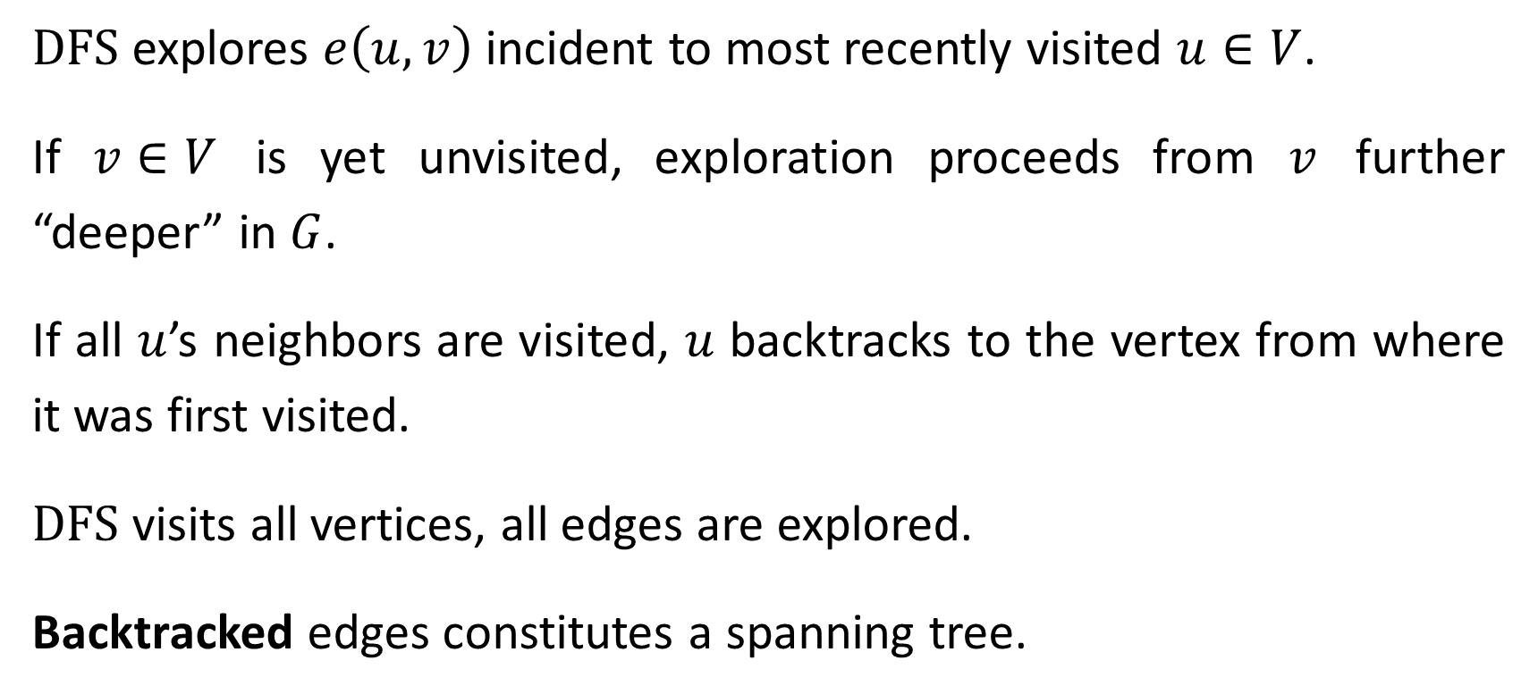
$\text{DFS}$ explores $e\left(u,v\right)$ incident to most recently visited $u∈V$.
If $v∈V$ is yet unvisited, exploration proceeds from $v$ further “deeper” in $G$.
If all $u$’s neighbors are visited, $u$ backtracks to the vertex from where it was first visited.
$\text{DFS}$ visits all vertices, all edges are explored.
Backtracked edges constitutes a spanning tree.

Slide 17
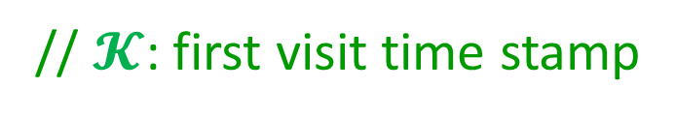

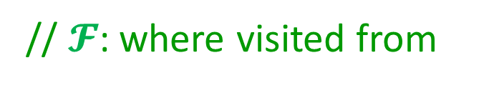
$$\text{Procedure} \text{DFS}\left(G\left(V,E\right), s;𝓚,𝓕\right)$$
$∀e∈E \text{mark} e \text{"}\text{new}\text{"}$
$∀v∈V \text{do} 𝓚\left[v\right]=0 ; 𝓕\left[v\right]=∅$
$𝓚\left[s\right]=1; u=s\text{ ;} i=2;$
$\text{while} \text{∃ }\text{"}\text{new}\text{" }e\left(u,v\right) \text{||} 𝓕\left[u\right]≠∅$
$\text{if} \text{∃ }\text{"}\text{new}\text{" }e\left(u,v\right)$
$\text{mark} e \text{"}\text{old}“$
$\text{if} 𝓚\left[v\right]=0$
$𝓕\left[v\right]=u ;𝓚\left[v\right]=i\text{++} ; u=v$
$\text{else} u=𝓕\left[u\right]$
// $𝓚$: first visit time stamp
// $𝓕$: where visited from
// explore all vertex neighbors
// first time visit
// set time stamp and proceed forward
// backtrack

Slide 18
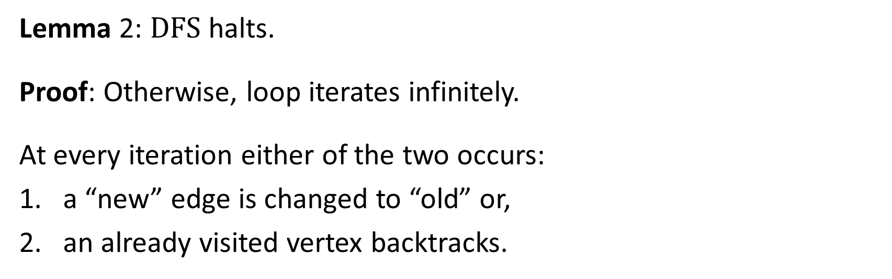




Lemma 2: $\text{DFS}$ halts.
Proof: Otherwise, loop iterates infinitely.
At every iteration either of the two occurs:
a “new” edge is changed to “old” or,
an already visited vertex backtracks.
$$𝓚\left[u\right]<𝓚\left[v\right]$$
$$u$$
$$v$$
$$𝓚\left[u\right]>𝓚\left[v\right]$$
Since the loop is conditioned by 1 or 2, 1 cannot occur infinite times.
So, 2 occur infinitely, ⇒ a cyclic backtracking.
backtracking

Slide 19
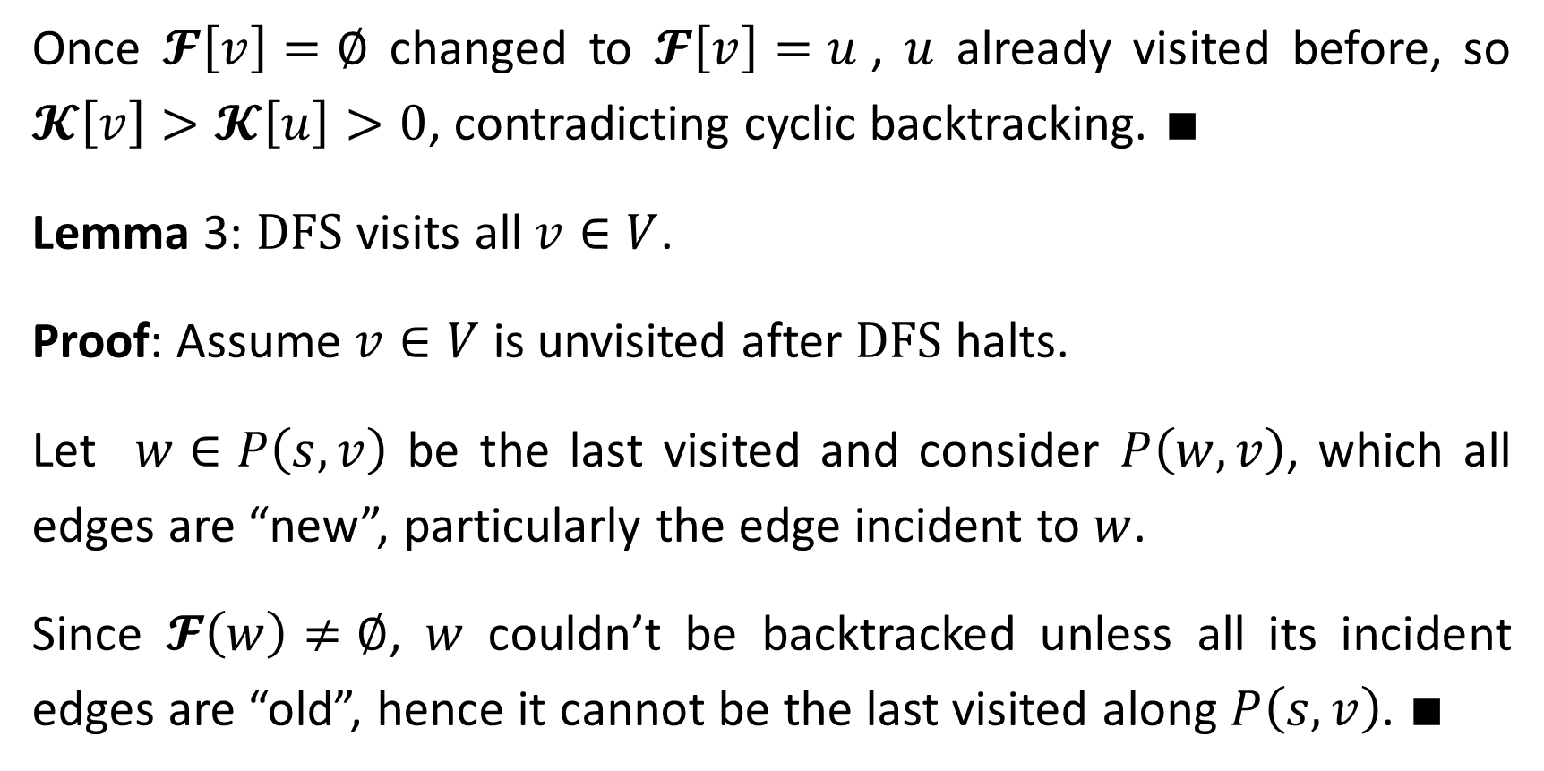
Once $𝓕\left[v\right]=∅$ changed to $𝓕\left[v\right]=u$, $u$ already visited before, so $𝓚\left[v\right]>𝓚\left[u\right]>0$, contradicting cyclic backtracking. $∎$
Lemma 3: $\text{DFS}$ visits all $v∈V$.
Proof: Assume $v∈V$ is unvisited after $\text{DFS}$ halts.
Let $w∈P\left(s,v\right)$ be the last visited and consider $P\left(w,v\right)$, which all edges are “new”, particularly the edge incident to $w$.
Since $𝓕\left(w\right)≠∅$, $w$ couldn’t be backtracked unless all its incident edges are “old”, hence it cannot be the last visited along $P\left(s,v\right)$. $∎$

Slide 20
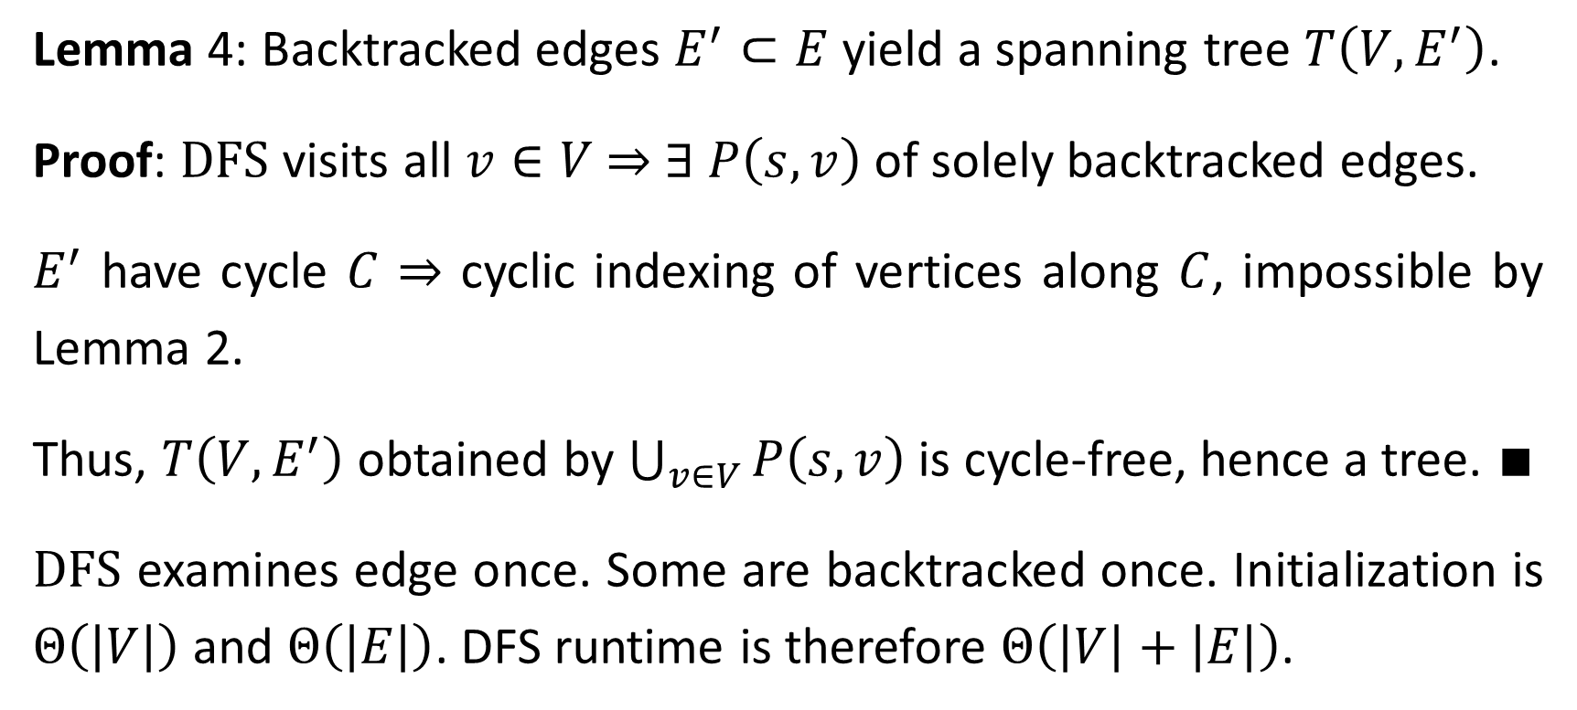
Lemma 4: Backtracked edges $E^{′}⊂E$ yield a spanning tree $T\left(V, E^{′}\right)$.
Proof: $\text{DFS}$ visits all $v∈V$ ⇒ $∃ P\left(s,v\right)$ of solely backtracked edges.
$E^{′}$ have cycle $C$ ⇒ cyclic indexing of vertices along $C$, impossible by Lemma 2.
Thus, $T\left(V, E^{′}\right)$ obtained by $\bigcup_{v∈V}{P\left(s,v\right)}$ is cycle-free, hence a tree. $∎$
$\text{DFS}$ examines edge once. Some are backtracked once. Initialization is $Θ\left(\left|V\right|\right)$ and $Θ\left(\left|E\right|\right)$. DFS runtime is therefore $Θ\left(\left|V\right|+\left|E\right|\right)$.

Slide 21
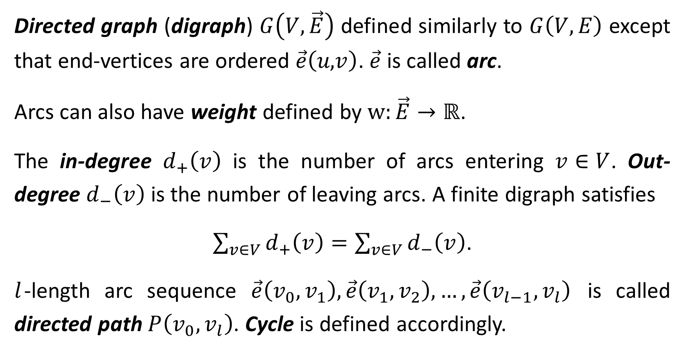
Directed graph (digraph) $G\left(V,\vec{E}\right)$ defined similarly to $G\left(V,E\right)$ except that end-vertices are ordered $\vec{e}\left(u\text{,}v\right)$. $\vec{e}$ is called arc.
Arcs can also have weight defined by $\text{w}:\vec{E}→ℝ$.
The in-degree $d_{+}\left(v\right)$ is the number of arcs entering $v∈V$. Out-degree $d_{−}\left(v\right)$ is the number of leaving arcs. A finite digraph satisfies
$\sum_{v∈V}{d_{+}\left(v\right)}=\sum_{v∈V}{d_{−}\left(v\right)}$.
$l$-length arc sequence $\vec{e}\left(v_{0},v_{1}\right),\vec{e}\left(v_{1},v_{2}\right),…,\vec{e}\left(v_{l−1},v_{l}\right)$ is called directed path $P\left(v_{0},v_{l}\right)$. Cycle is defined accordingly.

Slide 22
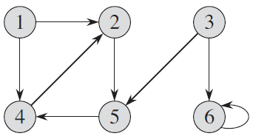
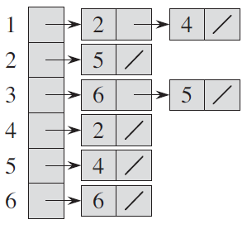
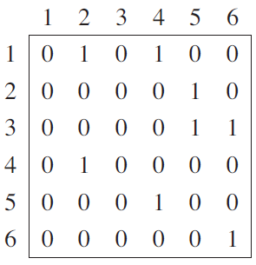
Adjacency list
Adjacency matrix
$\text{DFS}$ applicable to digraphs except $\vec{e}\left(v\text{,}u\right)$ replaces $e\left(v,u\right)$.

Slide 23

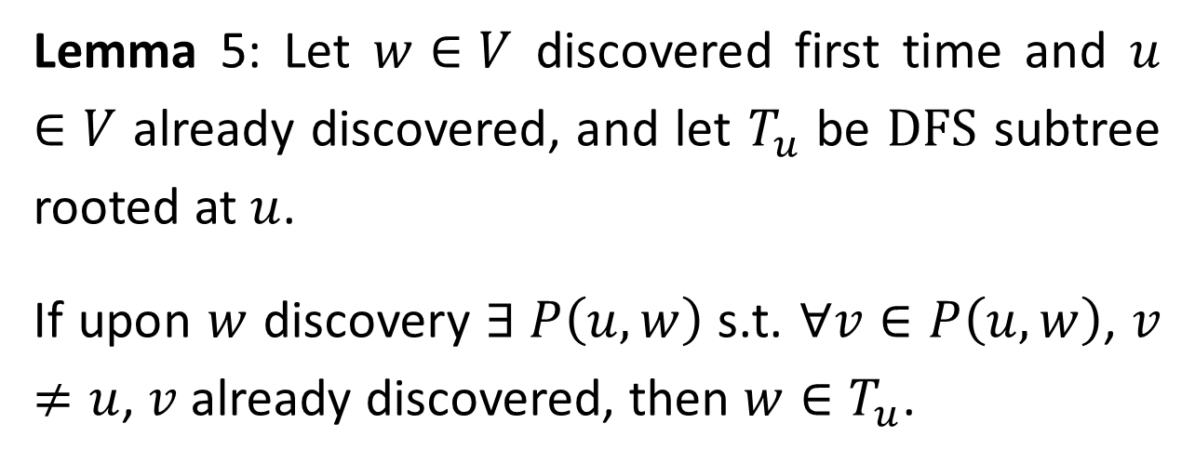



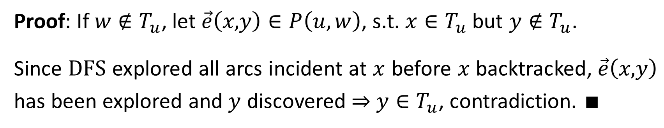

Lemma 5: Let $w∈V$ discovered first time and $u∈V$ already discovered, and let $T_{u}$ be $\text{DFS}$ subtree rooted at $u$.
If upon $w$ discovery $∃ P\left(u,w\right)$ s.t. $∀v∈P\left(u,w\right)$, $v≠u$, $v$ already discovered, then $w∈T_{u}$.
$$w$$
$$y$$
$$x$$
$$P\left(u,w\right)$$
$$u$$
Proof: If $w∉T_{u}$, let $\vec{e}\left(x\text{,}y\right)∈P\left(u,w\right)$, s.t. $x∈T_{u}$ but $y∉T_{u}$.
Since $\text{DFS}$ explored all arcs incident at $x$ before $x$backtracked, $\vec{e}\left(x\text{,}y\right)$ has been explored and $y$ discovered ⇒ $y∈T_{u}$, contradiction. $∎$

Slide 24
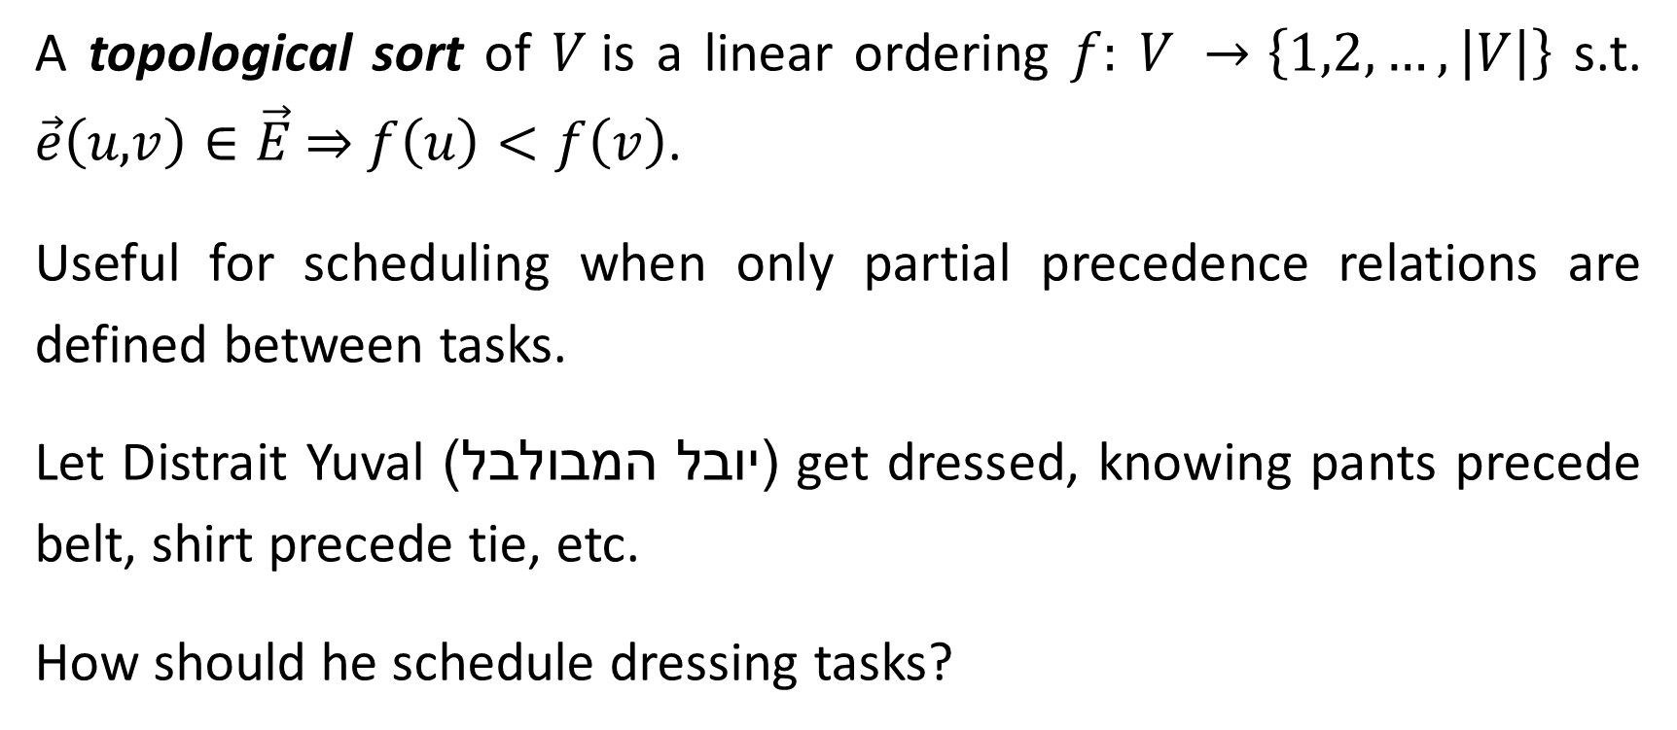
Topological Sort
A topological sort of $V$is a linear ordering $f:$ $V →\left\{1,2,…,\left|V\right|\right\}$ s.t. $\vec{e}\left(u\text{,}v\right)∈\vec{E}$ ⇒ $f\left(u\right)<f\left(v\right)$.
Useful for scheduling when only partial precedence relations are defined between tasks.
Let Distrait Yuval (יובל המבולבל) get dressed, knowing pants precede belt, shirt precede tie, etc.
How should he schedule dressing tasks?

Slide 25
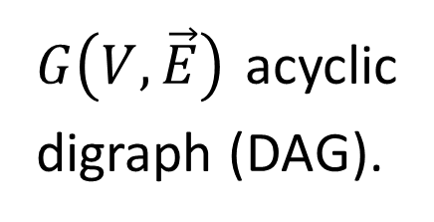
undershorts
socks
pants
shoes
$G\left(V,\vec{E}\right)$ acyclic digraph (DAG).
belt
shirt
tie
time
jacket
socks
undershorts
pants
shoes
shirt
belt
tie
jacket

Slide 26
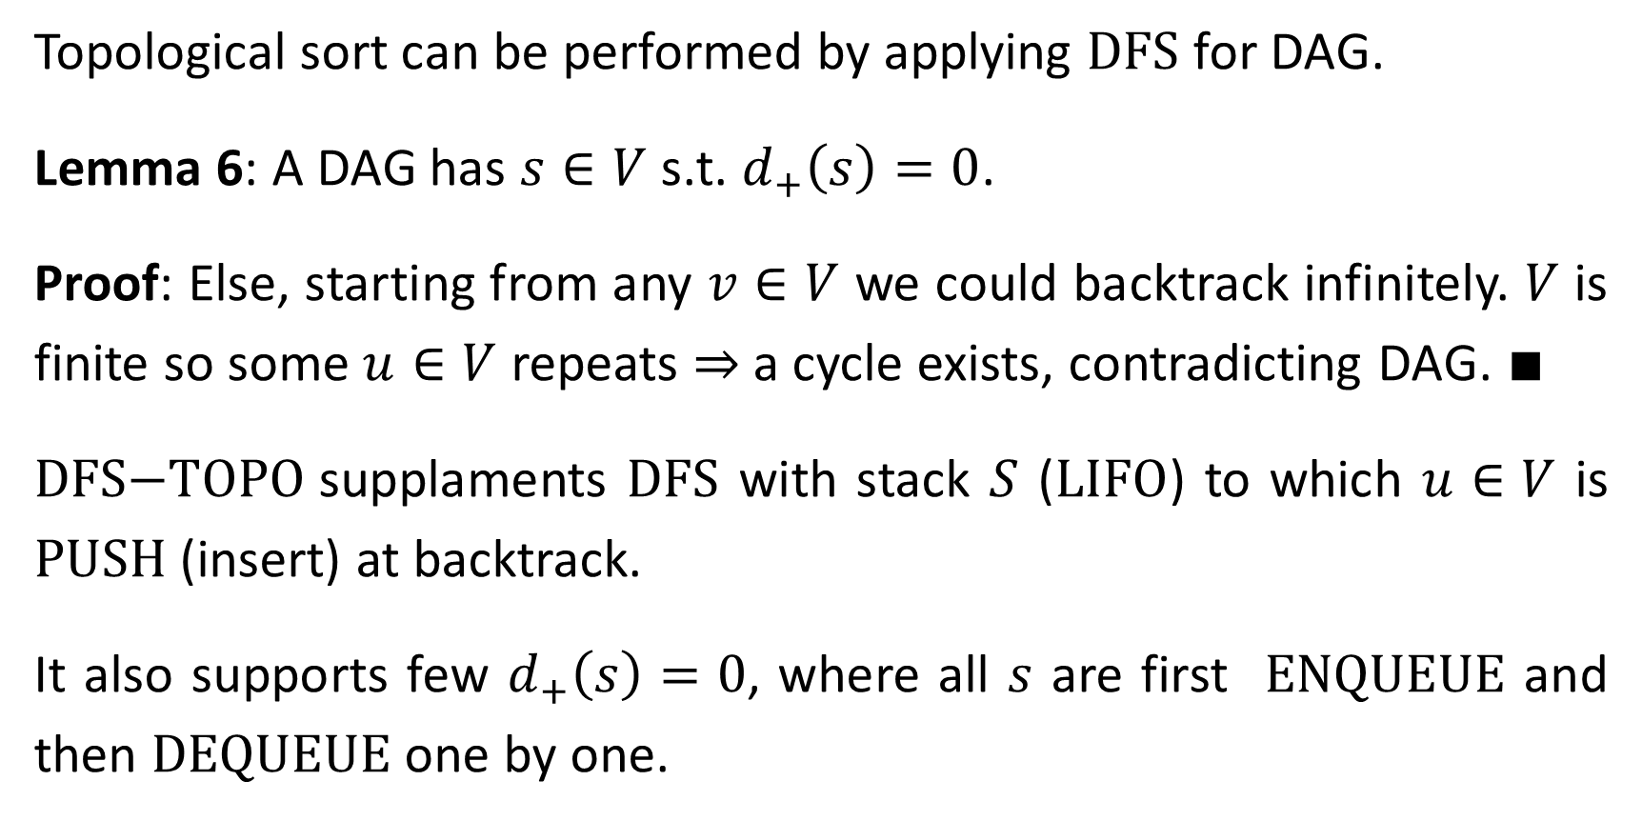
Topological sort can be performed by applying $\text{DFS}$ for DAG.
Lemma 6: A DAG has $s∈V$ s.t. $d_{+}\left(s\right)=0$.
Proof: Else, starting from any $v∈V$ we could backtrack infinitely. $V$ is finite so some $u∈V$ repeats ⇒ a cycle exists, contradicting DAG. $∎$
$\text{DFS}\text{−}\text{TOPO}$supplaments $\text{DFS}$ with stack $S$ ($\text{LIFO}$) to which $u∈V$ is $\text{PUSH}$ (insert) at backtrack.
It also supports few $d_{+}\left(s\right)=0$, where all $s$ are first $\text{ENQUEUE}$ and then $\text{DEQUEUE}$ one by one.

Slide 27
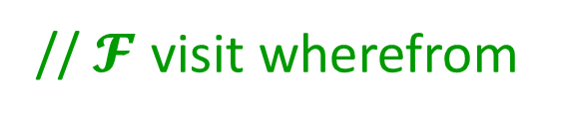

$$\text{Procedure} \text{DFS}\text{−}\text{TOPO}\left(G\left(V,\vec{E}\right);𝓕,S\right)$$
$∀s∈V$ s.t. $d_{+}\left(s\right)=0$ $\text{ENQUEUE}\left(Q, s\right)$
$∀e∈E \text{mark} e \text{"}\text{new}\text{"}$
$∀v∈V \text{do} 𝓕\left[v\right]=∅$
$\text{while} s=\text{DEQUEUE}\left(Q\right)≠∅$
$u=s$
$\text{while} u has \text{"}\text{new}\text{" }edge \vec{e}\left(u\text{,}v\right)$ ||$𝓕\left[u\right]≠∅$
$\text{if} v has \text{"}\text{new}\text{"} edge \vec{e}\left(u\text{,}v\right)$
$\text{mark} e \text{"}\text{old}“$
$\text{if} 𝓕\left[v\right]=∅ 𝓕\left[v\right]=u ; u=v$
$\text{else} \text{PUSH}\left(S,u\right); u\text{=}𝓕\left[u\right]$
//$𝓕$ visit wherefrom
// explore all vertex neighbors
// first time visit
// backtrack

Slide 28
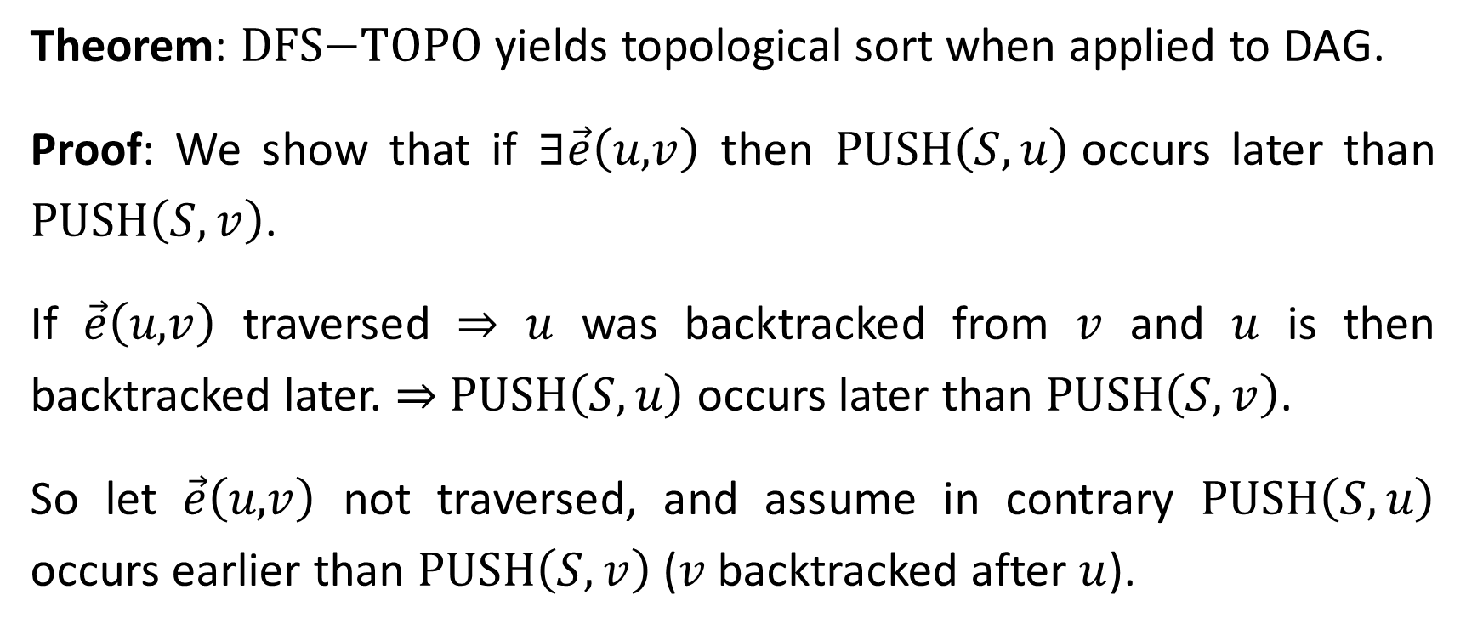
Theorem: $\text{DFS}\text{−}\text{TOPO}$ yields topological sort when applied to DAG.
Proof: We show that if $∃\vec{e}\left(u\text{,}v\right)$ then $\text{PUSH}\left(S,u\right)$occurs later than $\text{PUSH}\left(S,v\right)$.
If $\vec{e}\left(u\text{,}v\right)$ traversed ⇒ $u$ was backtracked from $v$ and $u$ is then backtracked later. ⇒ $\text{PUSH}\left(S,u\right)$ occurs later than $\text{PUSH}\left(S,v\right)$.
So let $\vec{e}\left(u\text{,}v\right)$ not traversed, and assume in contrary $\text{PUSH}\left(S,u\right)$ occurs earlier than $\text{PUSH}\left(S,v\right)$ ($v$ backtracked after $u$).

Slide 29



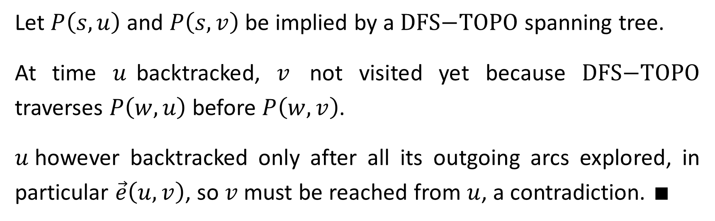




Let $P\left(s,u\right)$ and $P\left(s,v\right)$ be implied by a $\text{DFS}\text{−}\text{TOPO}$ spanning tree.
At time $u$backtracked, $v$ not visited yet because $\text{DFS}\text{−}\text{TOPO}$ traverses $P\left(w,u\right)$ before $P\left(w,v\right)$.
$u$however backtracked only after all its outgoing arcs explored, in particular $\vec{e}\left(u,v\right)$, so $v$ must be reached from $u$, a contradiction. $∎$
$$s$$
$$P\left(w,u\right)$$
$$w$$
$$\vec{e}\left(u,v\right)$$
$$P\left(w,v\right)$$
$$u$$
$$v$$

Slide 30
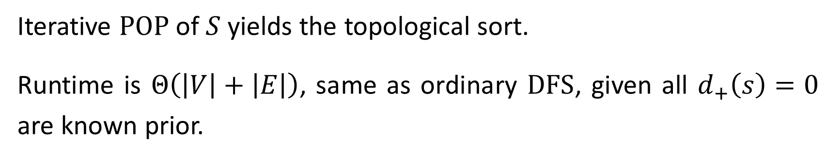
Iterative $\text{POP}$ of $S$yields the topological sort.
Runtime is $Θ\left(\left|V\right|+\left|E\right|\right)$, same as ordinary $\text{DFS}$, given all $d_{+}\left(s\right)=0$ are known prior.

Slide 31





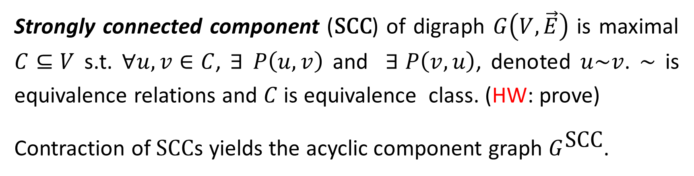


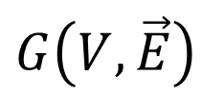






Strongly Connected Components
Strongly connected component ($\text{SCC}$) of digraph $G\left(V,\vec{E}\right)$ is maximal $C⊆V$ s.t. $∀u, v∈C$, ∃$P\left(u,v\right)$ and ∃ $P\left(v,u\right)$, denoted $u\sim v$. $\sim$ is equivalence relations and $C$ is equivalence class. (HW: prove)
Contraction of $\text{SCC}$s yields the acyclic component graph $G^{\text{SCC}}$.
$$a$$
$$b$$
$$c$$
$$d$$
$$abe$$
$$cd$$
$$G\left(V,\vec{E}\right)$$
$$G^{\text{SCC}}$$
$$f$$
$$g$$
$$fg$$
$$h$$
$$e$$
$$h$$

Slide 32






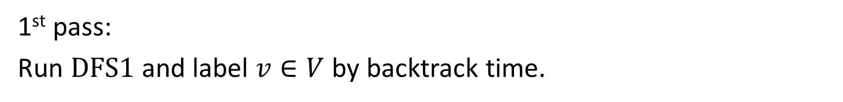


$$6$$
$$8$$
$$5$$
$$4$$
$$7$$
$$1$$
$$3$$
$$2$$
1st pass:
Run $\text{DFS}\text{1}$ and label $v∈V$ by backtrack time.

Slide 33

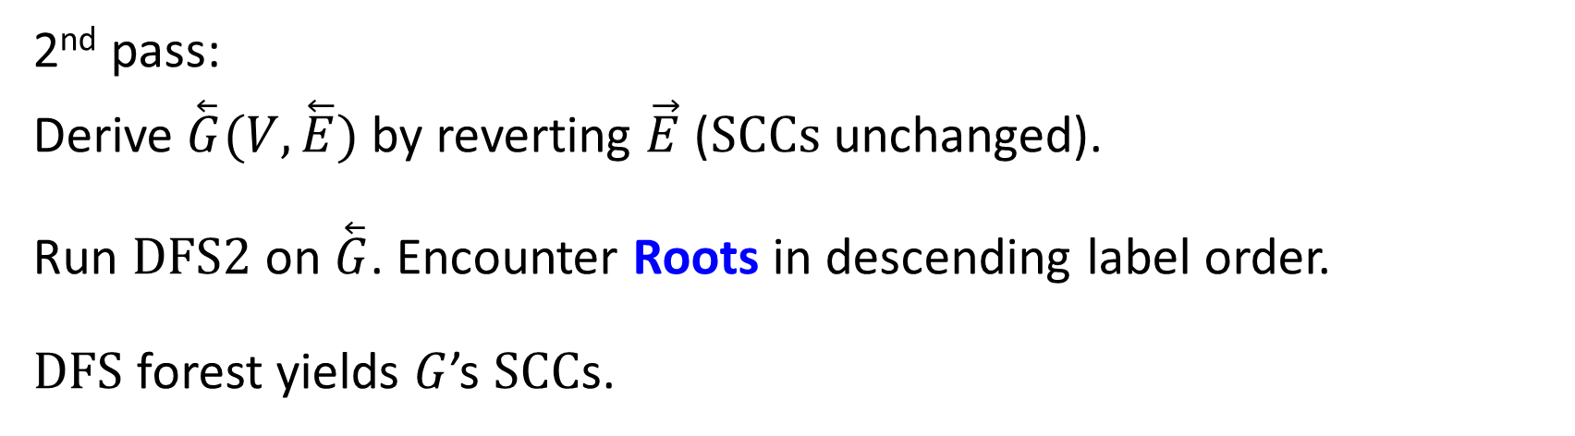







$$6$$
$$8$$
$$5$$
$$4$$
$$7$$
$$1$$
$$3$$
$$2$$
2nd pass:
Derive $\overset{⃖}{G}(V,\overset{⃖}{E})$ by reverting $\vec{E}$ ($\text{SCCs}$ unchanged).
Run $\text{DFS}\text{2}$ on $\overset{⃖}{G}$. Encounter Roots in descending label order.
$\text{DFS}$ forest yields $G$’s $\text{SCC}$s.

Slide 34
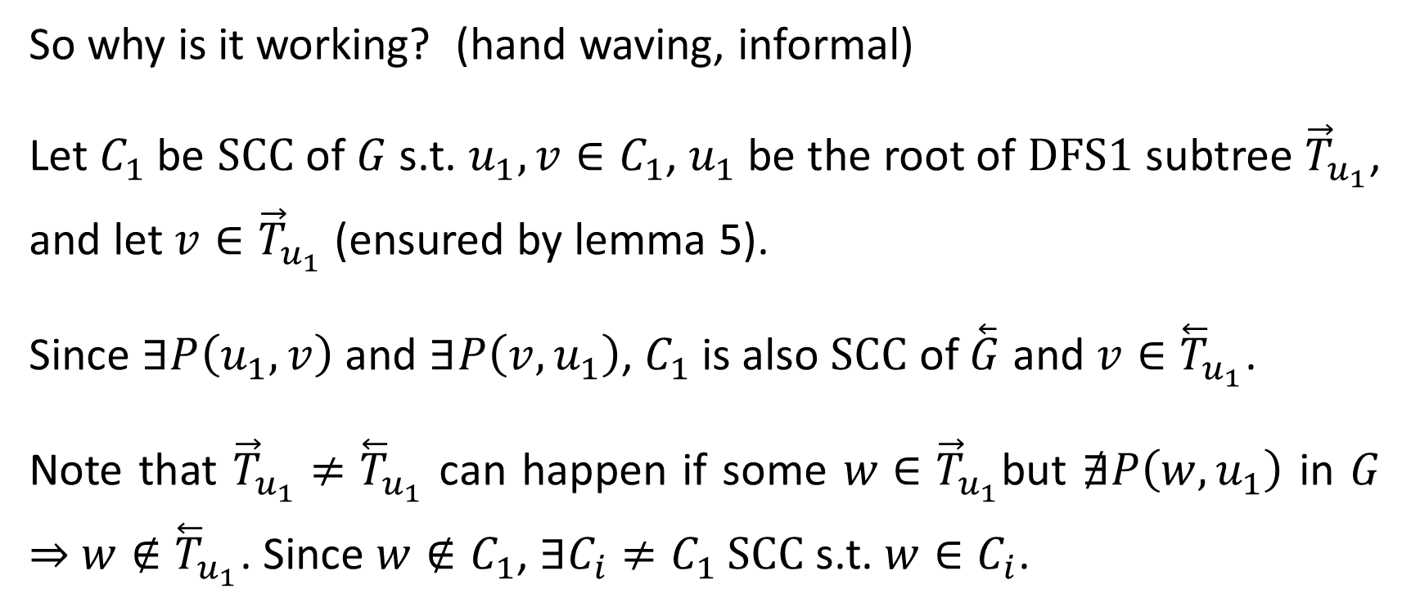
So why is it working? (hand waving, informal)
Let $C_{1}$ be $\text{SCC}$ of $G$s.t. $u_{1}, v∈C_{1}$, $u_{1}$ be the root of $\text{DFS}\text{1}$ subtree ${\vec{T}}_{u_{1}}$, and let $v∈{\vec{T}}_{u_{1}}$ (ensured by lemma 5).
Since $∃P\left(u_{1},v\right)$ and $∃P\left(v,u_{1}\right)$, $C_{1}$ is also $\text{SCC}$ of $\overset{⃖}{G}$ and $v∈{\overset{⃖}{T}}_{u_{1}}$.
Note that ${\vec{T}}_{u_{1}}≠{\overset{⃖}{T}}_{u_{1}}$ can happen if some $w∈{\vec{T}}_{u_{1}}$but $∄P\left(w,u_{1}\right)$ in $G$ ⇒ $w∉{\overset{⃖}{T}}_{u_{1}}$. Since $w∉C_{1}$, ∃$C_{i}≠C_{1}$ SCC s.t. $w∈C_{i}$.

Slide 35
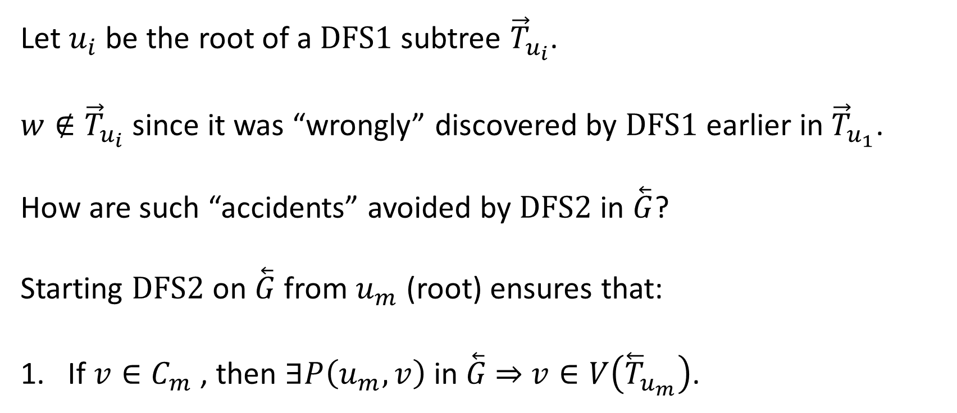
Let $u_{i}$ be the root of a $\text{DFS}\text{1}$ subtree ${\vec{T}}_{u_{i}}$.
$w∉{\vec{T}}_{u_{i}}$ since it was “wrongly” discovered by $\text{DFS}\text{1}$ earlier in ${\vec{T}}_{u_{1}}$.
How are such “accidents” avoided by $\text{DFS}\text{2}$ in $\overset{⃖}{G}$?
Starting $\text{DFS}\text{2}$ on $\overset{⃖}{G}$ from $u_{m}$ (root) ensures that:
If $v∈C_{m}$ , then $∃P\left(u_{m},v\right)$ in $\overset{⃖}{G}$ ⇒ $v∈V\left({\overset{⃖}{T}}_{u_{m}}\right)$.

Slide 36
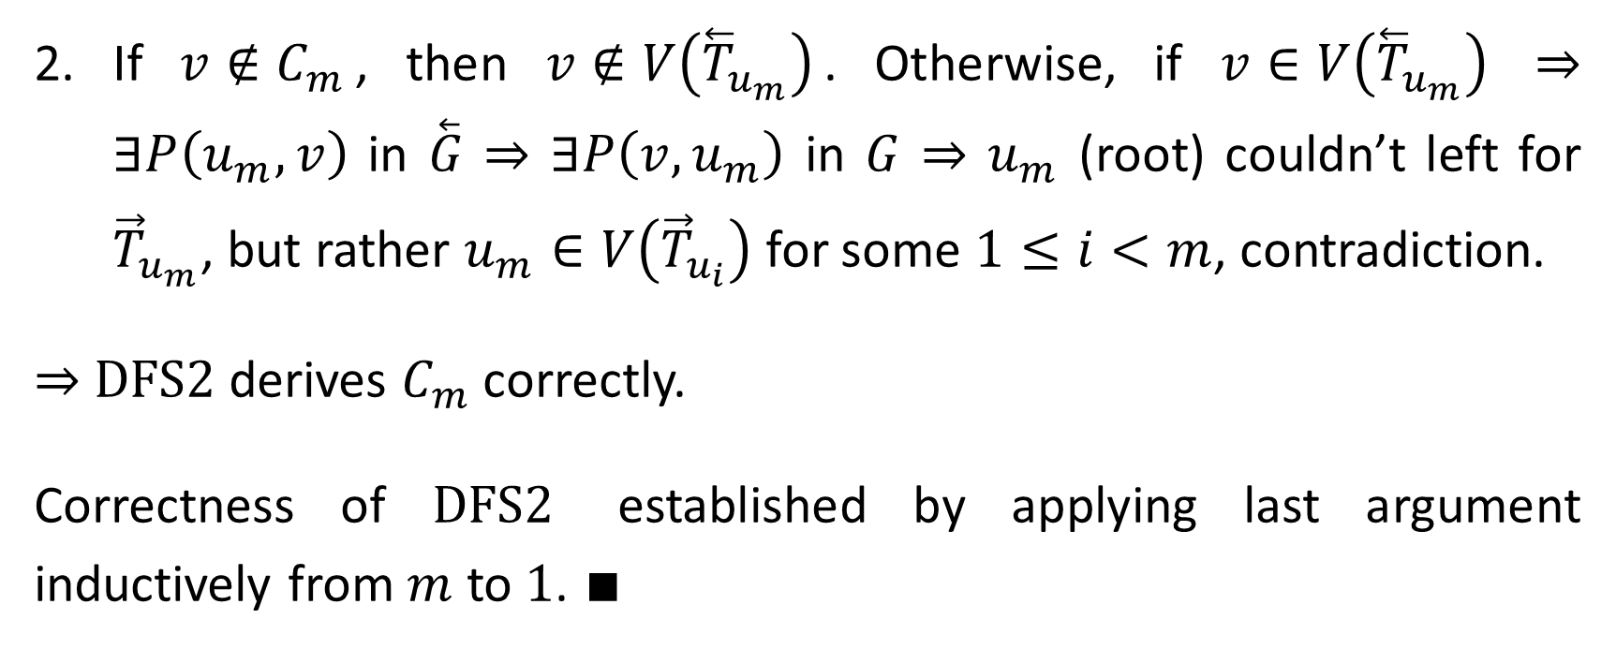
If $v∉C_{m}$, then $v∉V\left({\overset{⃖}{T}}_{u_{m}}\right)$. Otherwise, if $v∈V\left({\overset{⃖}{T}}_{u_{m}}\right)$ ⇒ $∃P\left(u_{m},v\right)$ in $\overset{⃖}{G}$ ⇒ $∃P\left(v,u_{m}\right)$ in $G$ ⇒ $u_{m}$ (root) couldn’t left for ${\vec{T}}_{u_{m}}$, but rather $u_{m}∈V\left({\vec{T}}_{u_{i}}\right)$ for some $1≤i<m$, contradiction.
⇒ $\text{DFS}\text{2}$ derives $C_{m}$ correctly.
Correctness of $\text{DFS}\text{2}$ established by applying last argument inductively from $m$ to $1$. $∎$

Slide 37
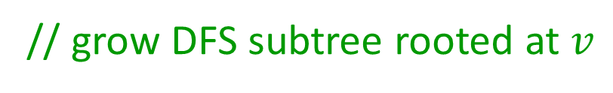

$$\text{Procedure} \text{DFS}\text{1}\left(G\left(V,\vec{E}\right);𝓗\right)$$
$∀e∈\vec{E} \text{mark} e \text{"}\text{new}\text{"}$
$∀u∈V \text{mark} u \text{"}\text{new}\text{" }; 𝓕\left[u\right]=∅$
$i=1$
$\text{while}$ ∃ $\text{"}\text{new}\text{"} v∈V$
$\text{mark} v \text{"}\text{old}\text{"}$
$\text{while} \text{∃ }\text{"}\text{new}\text{"} e\left(v\text{,}u\right) \text{||} 𝓕\left[v\right]≠∅$
$\text{if} \text{∃ }\text{"}\text{new}\text{" }e\left(v\text{,}u\right)$ $\text{mark} e \text{"}\text{old}\text{"}$
$\text{if} u is \text{"}\text{new}\text{"}$
$\text{mark} u \text{"}\text{old}\text{"}; 𝓕\left[u\right]=v;v=u$
$\text{else} 𝓗\left[v\right]=i\text{++} ;v=𝓕\left[v\right]$
$𝓗\left[v\right]=$ $i\text{++}$
// get root for new DFS subtree
// grow DFS subtree rooted at $v$
// explore new edge
// first time visit
// record backtrack time
// DFS subtree completed

Slide 38

$$\text{Procedure} \text{DFS}\text{2} \text{(}\overset{⃖}{G}(V,\overset{⃖}{E}),𝓗\text{; }\text{SSCs}\text{)}$$
$∀e∈\overset{⃖}{E} \text{mark} e \text{"}\text{new}\text{"}$
$∀u∈V \text{mark} u \text{"}\text{new}\text{"} ; 𝓕\left[u\right]=∅$
$\text{while}$ $($∃ $\text{"}\text{new}\text{"} w∈V)$
let $v ={argmax}_{\text{"}\text{new}\text{"}w∈V}{𝓗\left[w\right]}$
$\text{mark} v \text{"}\text{old}“ ;S=\left\{v\right\}$
$\text{while} \text{∃ }\text{"}\text{new}\text{" }e\left(v\text{,}u\right)\text{||} 𝓕\left[v\right]≠∅$
$\text{if} \text{∃ }\text{"}\text{new}\text{" }e\left(v\text{,}u\right)$ $\text{mark} e \text{"}\text{old}“$
$\text{if} u is \text{"}\text{new}\text{"}$
$\text{mark} u \text{"}\text{old}\text{"} ;𝓕\left[u\right]=v ;S=S∪\left\{v\right\} ;v=u$
$\text{else} v=𝓕\left[v\right]$
$\text{SSC}\text{s}=\text{SSC}\text{s}∪S$
// get largest backtrack time
// initialize new SCC and DFS subtree
// expand SCC
// backtrack
// SCC completed

